Slide 1


Real Estate Price Estimation using machine learning
Students: Joul Hourany & Asaad sajim
Supervisor: Dr. Reuven Cohen

Slide 2

Table of contents
Traditional Real Estate Valuation 3
The Problem 4
Existing Solutions 5
Our Solution 6
Software Architecture Diagram 7
Decision Tree 8
Random Forest 9
Dataset 10
Challenge 11
Prediction equation 12
Expectations 13
UseCase Diagram 14
Activity Diagram 15
User Interface 16
Testing 18
Valuations 19

Slide 3

Traditional Real Estate Valuation
On-Site Inspection
Compare to similar properties
Calculations

Slide 4

The problem
Challenges in Property Valuation:
Difficulty Finding Comparable Properties
Time-consuming processes.
High Costs
Impact: Difficulty in making fair decisions for buyers and sellers.

Slide 5

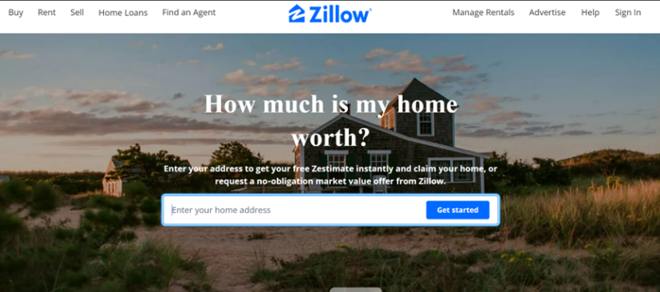
Existing Solutions
is a well-known platform in the United States.
Current Tools:
Online platforms like Zillow and Idealista.
is a platform mainly used in Spain, Italy, and Portugal.
Neither of them is designed for Israel.

Slide 6

Our Solution
Goal: A web platform that predicts real estate prices for the Israeli market.
Real-Time Property Valuation Using Machine Learning Model
User-Provided Property Features for Accurate Predictions
User-Friendly Interface for Instant Price Predictions and Key Factor Explanations

Slide 7
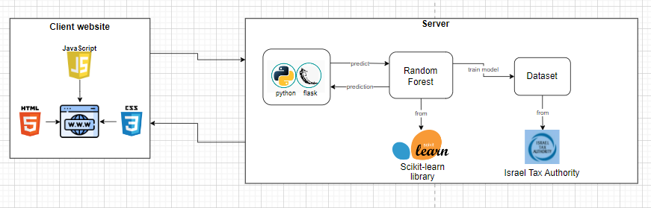
Software Architecture Diagram

Slide 8
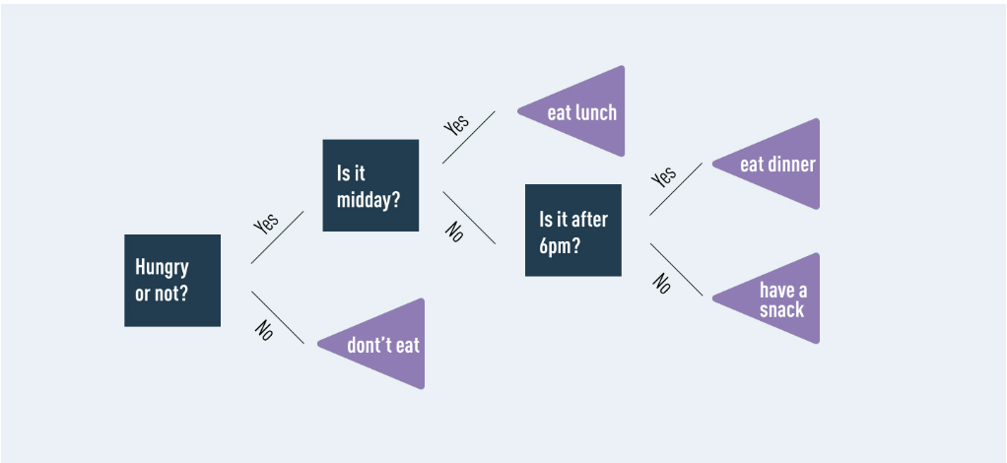
Decision Tree
It uses a series of branching questions or conditions based on the input features to classify or predict outcomes.
Each branch represents a decision, and the endpoints, known as "leaves" provide the final prediction or classification.
Example of a simple decision tree

Slide 9
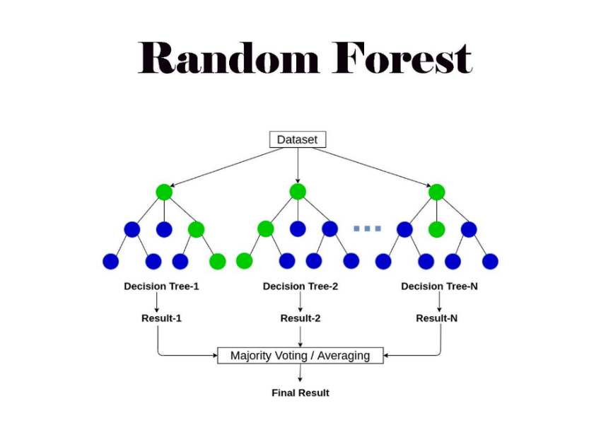
The model(random forest)
Multiple Trees
Grows multiple decision
trees to improve accuracy.
2. Averaging Predictions
Averages predictions from all trees for a final prediction.
Averaging

Slide 10
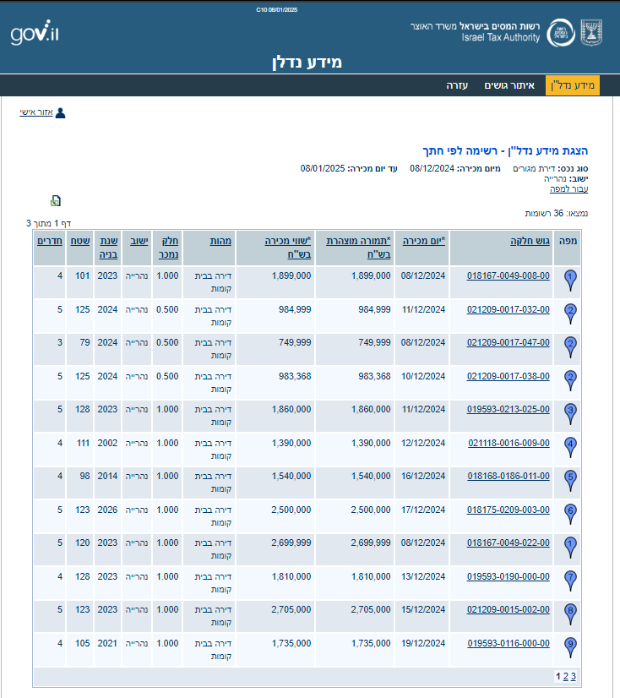
Dataset
The dataset is sourced from the "Israel Tax Authority" website.
It contains publicly available information on real estate transactions in Israel.
The dataset includes the following features:
Number of rooms
Area
Year built
City
Property type (apartment, single-family home, community housing, etc.)
Price

Slide 11

Challenge: Completing the missing data
Missing Data can affect property prices.
Missing Data:
Parking
Elevator
View
Proximity to:
Schools
Shopping center
Transport
Parks

Slide 12
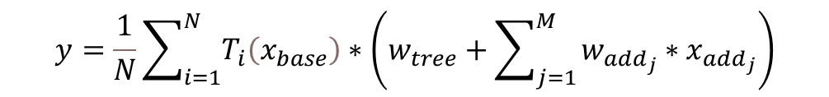


The prediction equation
The prediction from the i-th decision tree.
The predicted property price
Vector of base features
The number of additional features.
$$y=\frac{1}{N}\sum_{i=1}^{N}{T_{i}\left(x_{base}\right)}∗\left(w_{tree}+\sum_{j=1}^{M}{w_{{add}_{j}}∗x_{{add}_{j}}}\right)$$
Binary value of the j-th additional feature provided by the user (1 = exist, 0 = doesn’t exist)
The number of decision trees in the random forest.
The weight of the diction tree's price-output.
The Weight assigned to the j-th additional feature
$$\frac{1}{N}\sum_{i=1}^{N}{T_{i}\left(x_{base}\right)}∗w_{tree}$$
$$\sum_{j=1}^{M}{w_{{add}_{j}}∗x_{{add}_{j}}}$$
This part calculates the predicted price
based on the existing property features in the database.
This part adds the influence of the additional features.
(The missing data)
More important features have higher weights.

Slide 13
Expectations
Accuracy and Performance
Fast response time
At least 90% accuracy for price prediction.
Ease of Use
Simple user interface.

Slide 14
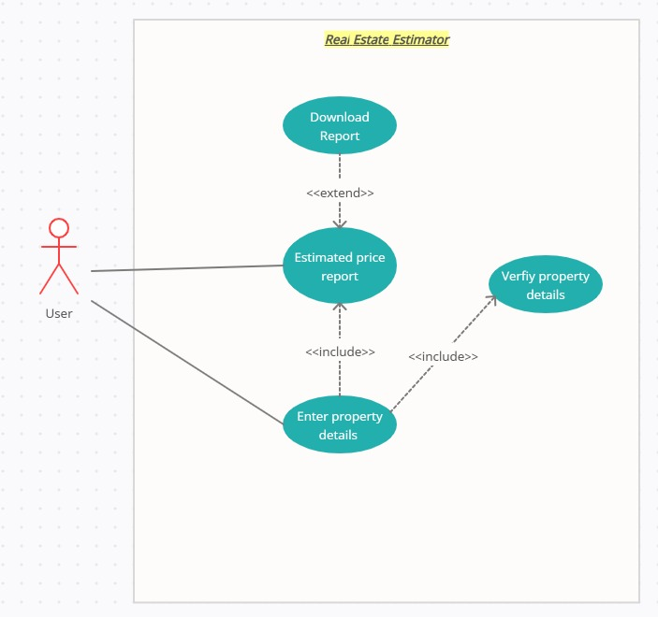
USE CASE

Slide 15
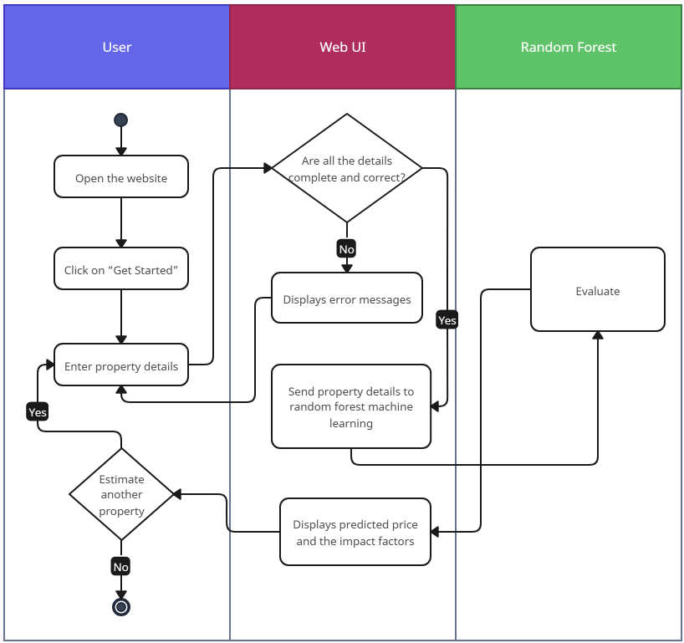
Activity diagram

Slide 16
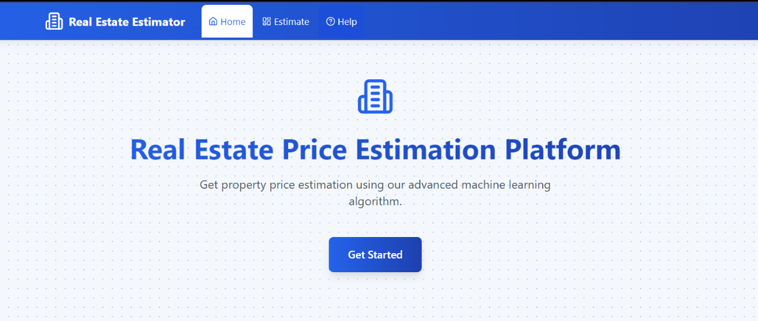
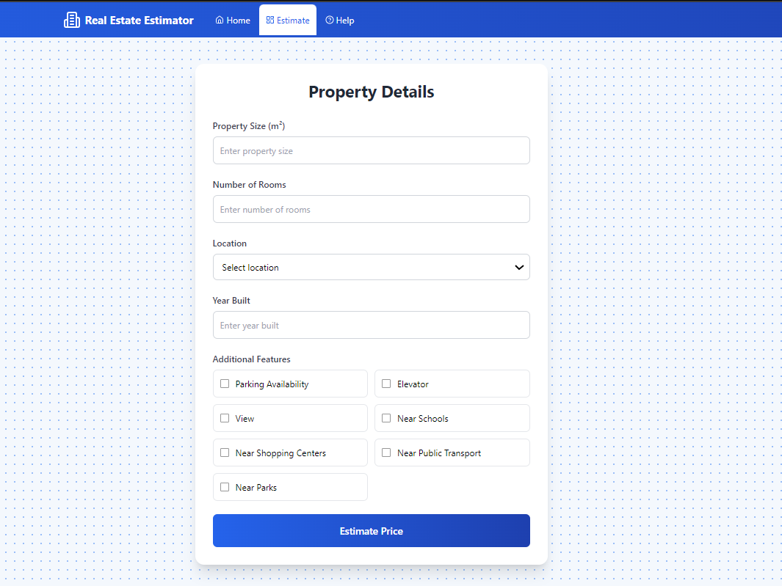
User interface
Home Page
Estimate Page (Property Form)

Slide 17
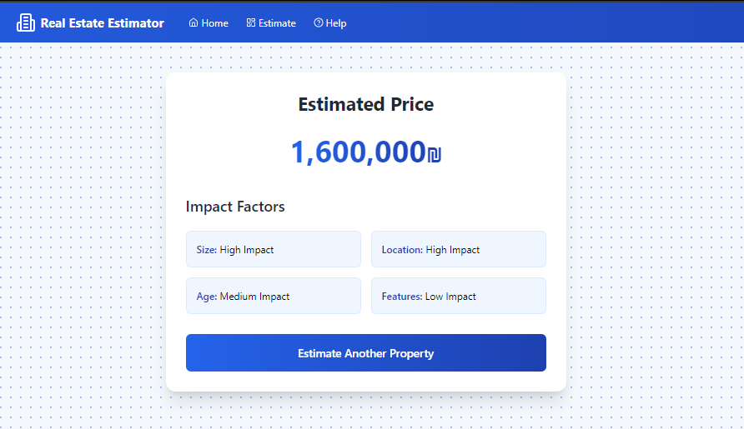
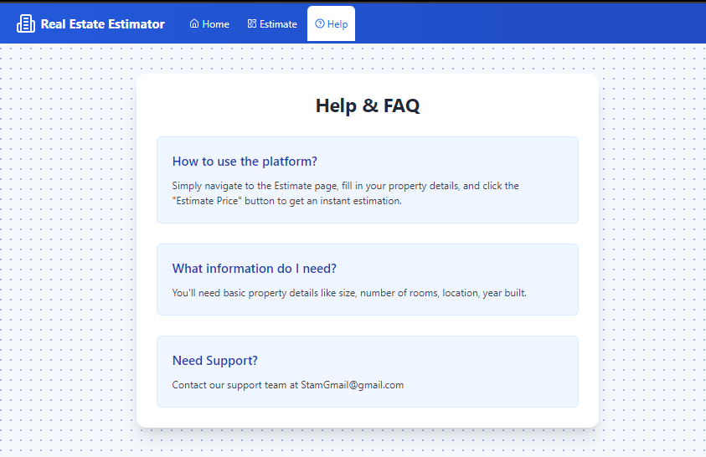
User interface
Help Page
Results Page

Slide 18
Testing
Case | Test Case | Expected Result
1 | Press "Get Started". | The user is taken to the next page (Estimate page).
2 | Entering the necessary property details correctly and completely and Press” Estimate Price”. | The system accepts the details and proceeds to estimate the property price, the result (price + impact factors) is displayed to the user.
3 | Entering the necessary property details not correctly or not completely and Press” Estimate Price”. | Error is shown: “The property details you entered are incomplete or incorrect. Please review the information and try again. ”
4 | Press "Estimate another property" | The user is taken to the Estimate page to start a new estimation.
5 | Access Help & FAQ | The system redirects the user to the Help & FAQ section.
6 | Return to the main page | The system redirects the user to the home page.
7 | No result output in the final step | Error is shown: “An error occurred while evaluating the property details. Please try again.”

Slide 19

Validation
Model:
Using recent valuations done by appraisers (not from the database).
We will use Root Mean Square Error (RMSE) to measure the accuracy of the price.
$$RMSE=\sqrt{\frac{1}{n}\sum_{i=1}^{n}{{(y_{i}−{\hat{y}}_{i})}^{2}}}$$
User Experience:
Collecting feedback from both appraisers and non-appraisers.

Slide 20

THANK YOU

